Slide 1
WORLD COUNTRIES GEOGRAPHICAL DATA
Latitude & Longitude

Slide 2
APPROACH
Web Scraping
CSV file
Geo DataFrame
&
Visualization
Collecting Countries' Longitude and Latitude data through web scraping method
Creating a csv file
Transforming the file into a GeodataFrame for interpretation and visualization

Slide 3
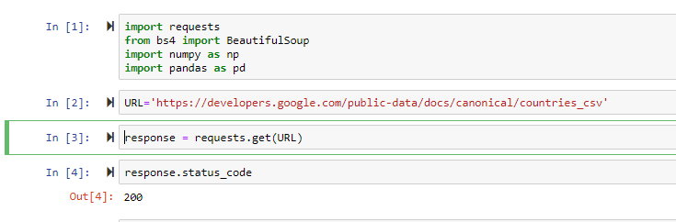
Importing Libraries
Importing requests
Importing BeautifulSoup
Import numpy as np
Import pandas as pd
URL link
Response code :200

Slide 4
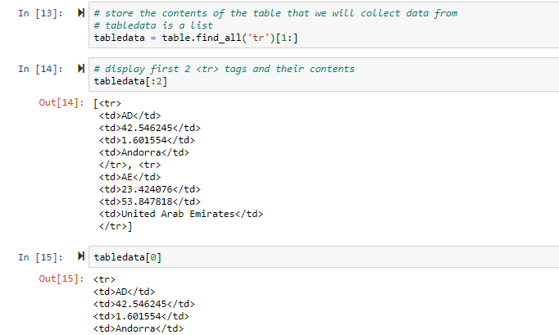
Storing Data
Storing the contents of the table that will collect data from tabledata

Slide 5
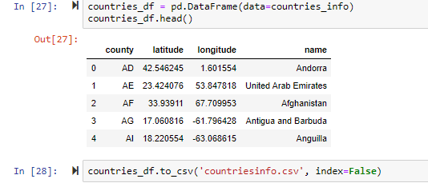
DataFrame
Data Collection
Converting Data into a CSV file

Slide 6
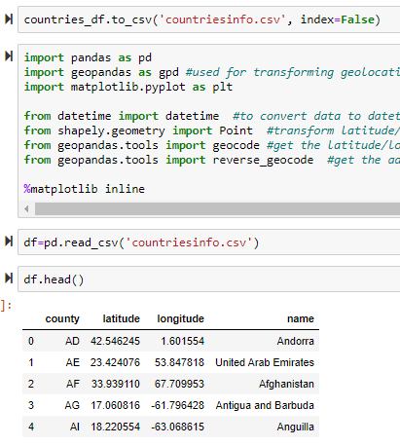
IMPORTING Libraries
Importing Geo Libraries
Importing CSV file

Slide 7
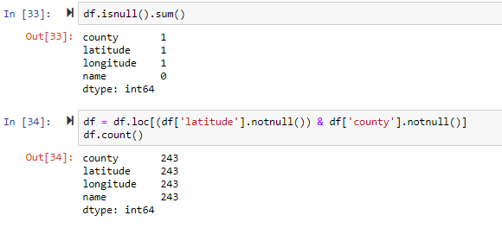
CLEANING
Cleaning Data
Only include rows with non-null latitudes (which means longitude is also not null) and non-null Countries

Slide 8
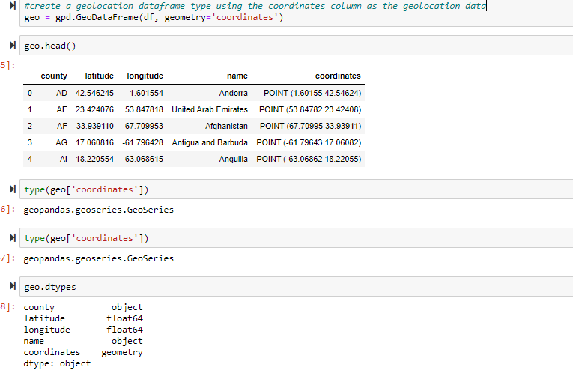
Coordinates to Geometry
Creating a geolocation DataFrame type by converting data coordinates into geometry ones

Slide 9
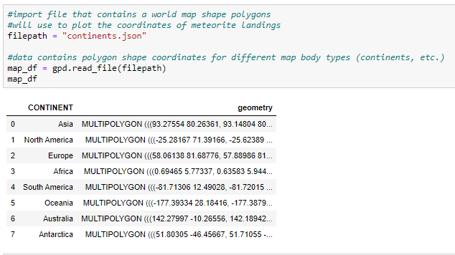
Importing Json file
Importing file that contains a world map shape polygons

Slide 10
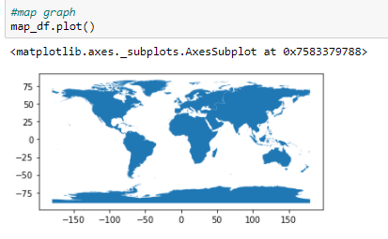
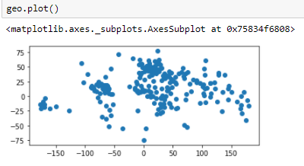
Visualization
World Map
Countries

Slide 11
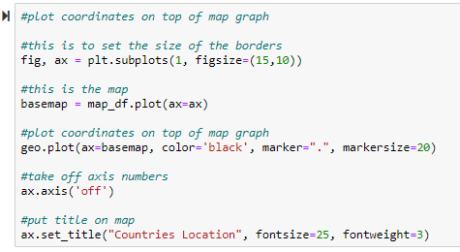
Plotting
Plotting coordinates

Slide 12
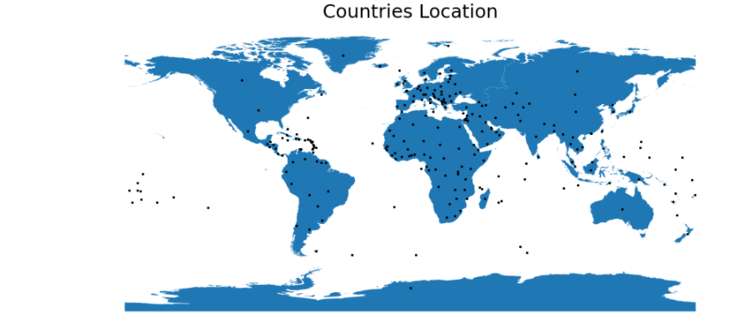
VISUALIZATION

Slide 14
QUESTIONS

